Slide 1
TYPE OF CONSTRUCTOR

Slide 2
Types of Constructor
There are five types of constructors available in C#, they are as follows :
Default or Parameter Less Constructor
Parameterized Constructor
Copy Constructor
Static Constructor

Slide 3
Default or Parameterless Constructors
If a constructor method does not take any parameters, then we call that a Default or Parameter Less Constructor. These constructors can be defined by a programmer explicitly or else will be defined implicitly provided there is no explicit constructor under the class. So, the Default or Parameterless Constructors are again classified into two types. They are as follows:
System-Defined Default Constructor
That constructor is called a default constructor and the default constructor is parameterless. The default constructor will assign default values to the data members (non-static variables). As this constructor is created by the system this is also called a system-defined default constructor.
User-Defined Default Constructor
The constructor which is defined by the user without any parameter is called the user-defined default constructor. This constructor does not accept any argument but as part of the constructor body, you can write your own logic.

Slide 4




Slide 5
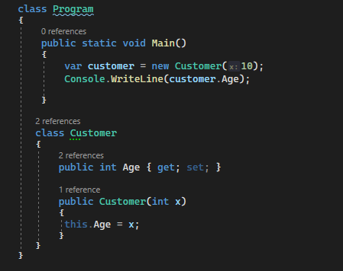

What is Parameterized Constructor
If a constructor method is defined with parameters, we call it a Parameterized Constructor in C#, and these constructors are defined by the programmers only but never can be defined implicitly. So, in simple words, we can say that the developer-given constructor with parameters is called Parameterized Constructor in C#. So, in this way, we can create any number of instances of the class, and while creating the instance we can pass different values and those values will go and sit in the variable.

Slide 6
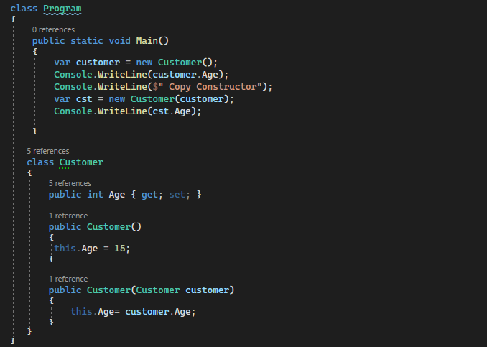

Copy Constructor
If we want to create multiple instances with the same values then we need to use the copy constructor in C#, in a copy constructor the constructor takes the same class as a parameter to it.

Slide 7
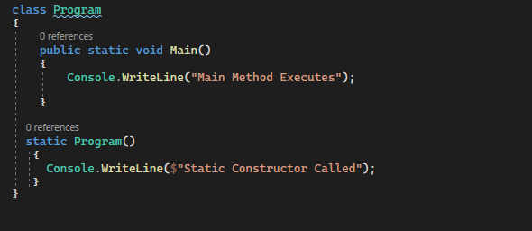

Static Constructor
In C#, it is also possible to create a constructor as static and when we do so, it is called a Static Constructor. If a constructor is declared explicitly by using the static modifier, then it is called a static constructor in C#. All the constructors we defined till now are non-static or instance constructors.
For a better understanding, please have a look at the below example. In a static constructor, you cannot use any access specifiers like public, private, and protected.
Static Constructors are responsible for initializing static variables and these constructors are never called explicitly. They are called Implicitly and moreover, these constructors are the first to execute in any class.
Static Constructors cannot be parameterized, so overloading of the static constructors is not possible in C#. Now, the question is why we cannot parameterize the static constructor? The answer is simple. The static constructors are executed implicitly and hence we never get a chance to pass a value.

Slide 8
Points To Remember About Static Constructor
There can be only one static constructor in a class.
It can’t be called explicitly, it is always called implicitly.
The static constructor should be without any parameters.
It can only access the static members of the class.
There should not be any access specifiers in the static constructor definition.
If a class is static then we cannot create the object for the static class.
It is called automatically to initialize the static members.
Static constructor will be invoked only once i.e. at the time of class loading.

Slide 9
What is a Private Constructor
In C#, it is also possible to create a constructor as private. The constructor whose accessibility is private is known as a private constructor. When a class contains a private constructor then we cannot create an object for the class outside of the class. So, private constructors are used to create an object for the class within the same class. Generally, private constructors are used in the Remoting concept.
Points To Remember about C# Private Constructor:
Using Private Constructor in C# we can implement the singleton design pattern.
We need to use the private constructor in C# when the class contains only static members.
Using a private constructor is not possible to create an instance from outside the class.

